Slide 1
General Membership Orientation
Getting the Most of Your PCC Membership
PCC EDUCATION PROGRAMMING
Notes:
Dina 1 minute
Welcome, purpose, and review of agenda

Slide 2
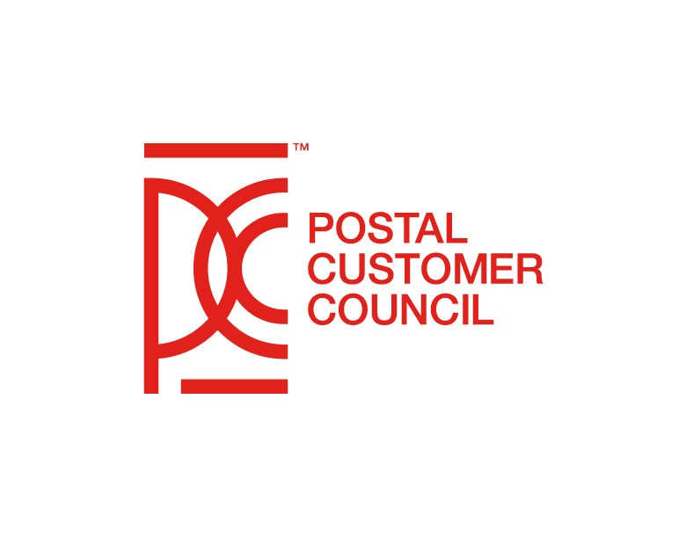
Dina Kessler
National Industry Chair
dkessler@kesslercreative.com
Lindsey Taylor
National Postal Vice Chairperson
lindsey.c.taylor@usps.gov
Cathy Scocco
National Postal Vice Chairperson
cathy.m.scocco@usps.gov
PCC EDUCATION PROGRAMMING

Slide 3
Housekeeping
Please utilize the chat box to ask questions, or voice any comments, or concerns.
Please note: All phones and videos will be muted due to the large volume of information that we are sharing on today’s call.
Notes:
Dina 1 minute
Please utilize the chat box to ask questions, voice any comments, or concerns.
Please note that all phones and videos will be muted due to the large volume of participants that we are expecting

Slide 4
Agenda
Welcome
Icebreaker
History of the PCC
Purpose of the PCC Advisory Committee (PCCAC)
PCCAC Sub-Committees:
Membership Growth and Recruitment
Strategic Innovation and PCC Policies
Communications and Marketing
Education Programming
Resources
Questions and Answers
Closing
Thank You
PCC EDUCATION PROGRAMMING
Notes:
Dina 2 minutes

Slide 5
Icebreaker
Sherwin Salla
A/Customer Outreach Specialist
Sherwin.S.Salla@usps.gov
PCC EDUCATION PROGRAMMING

Slide 6
Icebreaker
PCC EDUCATION PROGRAMMING

Slide 7
History of the PCC
Cornelius “Neal” Fedderman
National Industry Vice Chairperson
Neal_Fedderman@carmax.com
PCC EDUCATION PROGRAMMING
Notes:
Neal

Slide 8
History of the PCC
“The PCC® Program’s mission is to foster a close working relationship between the U.S. Postal Service and commercial mailers. Our goals are to share information about new and existing Postal Service business products, programs, services, and procedures. Through focused educational programs, the PCC® strives to help industry members and their organizations grow and develop professionally.”
PCC EDUCATION PROGRAMMING
Notes:
Neal 1 minute

Slide 9
History of the PCC
“The PCC® Program’s mission is to foster a close working relationship between the U.S. Postal Service and commercial mailers. Our goals are to share information about new and existing Postal Service business products, programs, services, and procedures.”
Identified an opportunity for better communication between local
mailers and the Post Office
Established in 1961 – Mail Users Council
Greater Baltimore and Greater Dallas
Supporting Business and Residential mailers
Later became known as the Citizens’ Advisory Councils (CAC)
Addressing the “Mail Early” campaign
PCC EDUCATION PROGRAMMING
Notes:
Neal 2 minutes

Slide 10
History of the PCC
“Through focused educational programs, the PCC® strives to help industry members and their organizations grow and develop professionally.”
1971 – The Citizens’ Advisory Committee changed their name
Postal Customer Council
Primary focus Business mailers
Addressing mailer issues and concerns
Focus on Education and Networking
144 PCCs representing 7,500 mailers
Avenue frequently used to improve customer service and satisfaction
Support corporate profitability for Business Mailers and USPS
PCCs Governing Body – Postal Customer Council Advisory Committee
PCC EDUCATION PROGRAMMING
Notes:
Neal 2 minutes

Slide 11
PCC Advisory Committee
Da Shiek Woodard
Customer Outreach Specialist
dashiek.f.woodard@usps.gov
PCC EDUCATION PROGRAMMING
Notes:
Da Shiek

Slide 12
Purpose of the PCC Advisory Committee
Oversight Body
Provides Guidance on PCC Practices
National effort to accomplish the PCC mission
Comprised of 4 Sub-Committees:
Communication & Marketing
Education Programming
Membership & Recruitment
Strategic Innovation & PCC Policy
PCC EDUCATION PROGRAMMING
Notes:
Da Shiek 5 minutes
The PCC Advisory Committee (PCCAC) functions as an oversight body, providing guidance on Postal Customer Council® (PCC) practices and bringing PCCs together for mutual gain in accomplishing the PCC mission. The committee is comprised of 4 voting postal members and 4 voting industry members.

Slide 13
Membership Growth and Recruitment
Judy Caldwell
Customer Outreach Specialist
Judith.R.Caldwell@usps.gov
Suzi Oswald
Industry Co-Chair
Suzi.Oswald@seachangemn.com
PCC EDUCATION PROGRAMMING

Slide 14
Definition
PCC membership consists of both Postal Service employees and representatives of the mailing industry. Membership is open to all business mailers who use the services of the Postal Service within the sponsoring Postal Service manager's geographic area.
PCC EDUCATION PROGRAMMING
Notes:
When discussing PCC membership, one of the first questions that arises is, “What is a PCC Member?” Is it someone who comes to a PCC event, someone on a PCC’s mailing list, someone who pays annual dues, or all of the above? The PCC Membership section of Pub 286 provides the Definition of a Member.
PCC membership consists of both Postal Service employees and representatives of the mailing industry. Membership is open to all business mailers who use the services of the Postal Service within the sponsoring Postal Service manager's geographic area.
For more information about PCC Membership, you can refer to Pub 286 on PostalPro under the Strategic Innovation and PCC Policy section.

Slide 15
Value and Benefits
Gain Inside Access to Products, Services, and Innovations
Stay in the Know
Get Easy Access to the PCC Community
Mail Facility Tours
Exhibition Opportunities
Special Events
https://about.usps.com/video/PCCPromo2020.mp4
PCC EDUCATION PROGRAMMING
Notes:
Value and Benefits of PCC Membership (Comment: Include video)
What are the value & benefits of becoming a member?
Gain inside access to products, services, and innovations – Get timely, close-up looks at Postal Service products, services, procedures, and tools that can help you improve your mail quality and streamline your fulfillment to grow your business. You will also have access to discuss your mailing and shipping needs with your local USPS Management Representative.
Stay in the know
Get expert advice and support with best practices that help improve mailing and shipping effectiveness, efficiency, and profitability. You will also keep tabs on the latest promotions and incentives, encouraging innovative mail uses and channel integration, as well as shipping trends to benefit your customer and your bottom line.
Note, if asked – (Channel integration refers to strategies aimed at consolidating – either physically or logically – customer information and its use to provide an all-encompassing view of the customer.)
Get easy access to the PCC community – Take advantage of PCC meetings with various speakers and topics plus educational workshops throughout the year. Which, include participation of both local and national postal and industry leaders whose insight and experience can give you a leg up.
Mail Facility Tours, Exhibition Opportunities, Webinars, workshops, Cafés, and Special Events - provides business members with information about postal products and services, tools to help grow their business, as well as improve their mail quality.
Before we continue the value and benefits, let’s first hear how members, just like yourself, feel about their PCC.

Slide 16
Value and Benefits (continued)
Membership Networking Opportunities
Sustain a Competitive Edge
Networking Advantages
The Power of Connections
PCC EDUCATION PROGRAMMING
Notes:
Suzi 2 minutes
Value & Benefits Continued
Membership Networking Opportunities
Take the opportunity to network with other businesses, mail service providers, and subject-matter experts on how to implement and optimize your direct mail and shipping needs.
Sustain a Competitive Edge - Stay on top. Businesses can collaborate on ways to help expand your business and improve your bottom line. Use the power of networking within the PCC to generate ideas, gain support, share best practices, and identify areas where business can collaborate. You’ll share industry referrals for services and vendors and enhance your relationship with local postal providers.
Networking Advantages
There are so many advantages of networking, but to name a few, they are:
an avenue to exchange ideas
it makes you noticeable
a path for new opportunities
a channel where you can gain more knowledge
it is a gateway to the industry
an extra resource library
a way to create long-lasting relationships
and much more.
The Power of Connections
Odds are that someone in your industry has already discovered a helpful solution in your niche. Workshops, meet-and-greets, virtual learning, forums, PCC Insider, PCC Voice, and local newsletters, websites, and email blasts are all opportunities to learn & share best practices and fresh ideas and spot emerging trends early on.
If you are not a member, I would encourage you to become a member, if you are a member, tell someone about your PCC and bring them to your next PCC meeting.
Don’t make the PCC the best kept secret!
And now, I will turn it back to Lewis

Slide 17
Strategic Innovation and PCC Policy
Katrina Raysor
Customer Outreach Specialist
katrina.r.raysor@usps.gov
Mark Fallon
Industry Co-Chair
mmf@berkshire-company.com
Monica O’Connor
Member-at-Large
Monica.oconnor@moneypages.com
PCC EDUCATION PROGRAMMING
Notes:
Kat, Mark and Monica

Slide 18
Leadership of a PCC
Partnership between postal and industry
Postal Co-Chair
Industry Co-Chair (elected by the general membership)
Treasurer
Secretary
Postal Administrator
Committee Chairs – marketing, membership, newsletters, education, public relations, website, events, etc.
Volunteers needed for all committees
PCC EDUCATION PROGRAMMING
Notes:
Kat 2 minutes
The Postal Customer Councils, The PCC is a postal-sponsored organization, and the leadership of the PCC demonstrates the partnership between industry and the USPS. There are two co-chairs, a postal co-chair and an industry co-chair. The postal co-chair is usually the local postmaster and is appointed by the USPS. The industry co-chair is an elected position by the general membership.
Other key board officer roles are the treasurer, secretary and postal admin.
There are also committee chairs, with each chair have a set area of responsibility. Common committees include marketing, membership, newsletters, education, PR, website, events, etc.
Each of these committee will include postal and industry members. The committee are always looking for new ideas and help. Consider volunteering to join one of the committee.

Slide 19
PCC Voice on LinkedIn
A LinkedIn group and a place for PCC members to:
Promote events
Share and exchange ideas
Ask questions
Post photos and information
Create a networking environment
Comment on other posts
Give a shoutout to others
Use this link to join the group: https://www.linkedin.com/groups/8303549
PCC EDUCATION PROGRAMMING
Notes:
Mark or Kat 1 minute
PCC Voice is a private group on LinkedIn. It is approved and monitored by the USPS team that supports PCCs.
PCC Voice is a place for PCC members to:
Promote events – both in-person and virtual events
Share and ideas – about what is working for your PCC. Special events, newsletters, videos are all appropriate; we are all here to support each other.
Ask questions – if you are looking for input on a program or event, the PCC Voice community is here to help.
Post photos and information – share your successes!
PCC Voice is the perfect platform to establish a networking environment.
The link is on the page. You must request to join. Membership is usually approved within one business day.

Slide 20
PCC Voice
DO
Publish posts
“Like” posts
Comment on posts
Respond to questions
DO NOT POST
Business advertisements
Self-promotion
Political posts
PCC EDUCATION PROGRAMMING
Notes:
Mark or Kat 1 minute
The PCC Voice group is here to promote and support PCCs. Please join and make posts. When visiting the group, take a moment and click “like” on posts. That simple action helps increase visibility of the post on LinkedIn. Consider adding a brief comment – “Great idea!” “Congratulations!” And also help your fellow PCC members by answering the questions that are posted. We are here to support each other.
There are a few “don’ts”. This is not the place to advertise your company. Nor is it a place to promote yourself or your accomplishments. And since we’re tal;king about social media – this is not a place for political posts.

Slide 21
Policy on Social Media
PCC Voice is the only approved social media for PCCs
Follow the rules when posting
Encourage other members to join
Personal pages
May promote PCC events
For PCC event posts, follow PCC Voice! Rules
Think before you post
Common sense
What would your mother think?`
PCC EDUCATION PROGRAMMING
Notes:
Monica 1 minute
The PCC Voice! Is the only approved social media for PCCs.
PCCs are not allowed to have twitter accounts or facebook accounts. When using PCC Voice, follow the few rules, participate and encourage other PCC members to join.
On your personal pages on any social media platform, you may promote a PCC event. However, still follow the PCC Voice rules on that post.
Whether posting on PCCs – or any other subject – think before you post! The internet is forever, and any post may end up being shared with the whole world. Use your common sense when sharing or posting. A good rule of thumb – consider what your mother – or any other person you hold in high regard – would think about what you just posted.

Slide 22
Communications and Marketing
Kathy Hall
Industry Co-Chair Kathy@ATIME4Marketing.com
Sharon Barger
Customer Outreach Specialist
Sharon.a.barger@usps.gov
PCC EDUCATION PROGRAMMING
Notes:
Kathy and Sharon

Slide 23
PCC Communications and Marketing
Purpose: Inform the PCC community of upcoming events; share PCC news and announcements from the industry and USPS; create marketing materials and recommend strategies to all PCCs nationwide regardless of size or available resources.
PCC EDUCATION PROGRAMMING
Notes:
Kathy 2 minutes

Slide 24
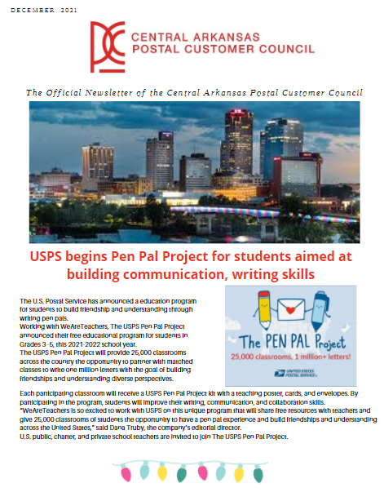
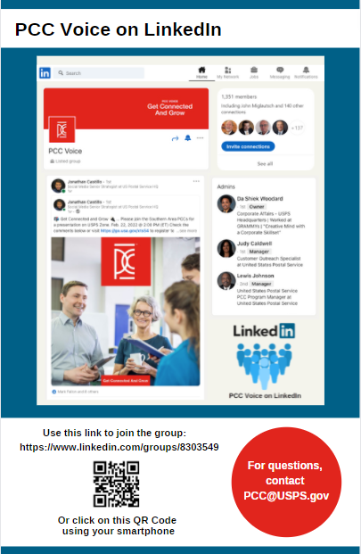
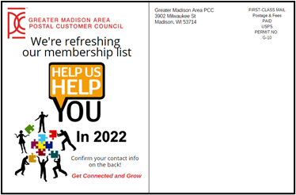
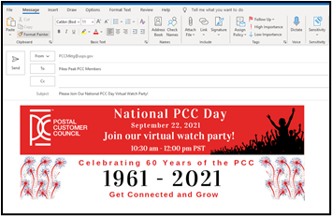
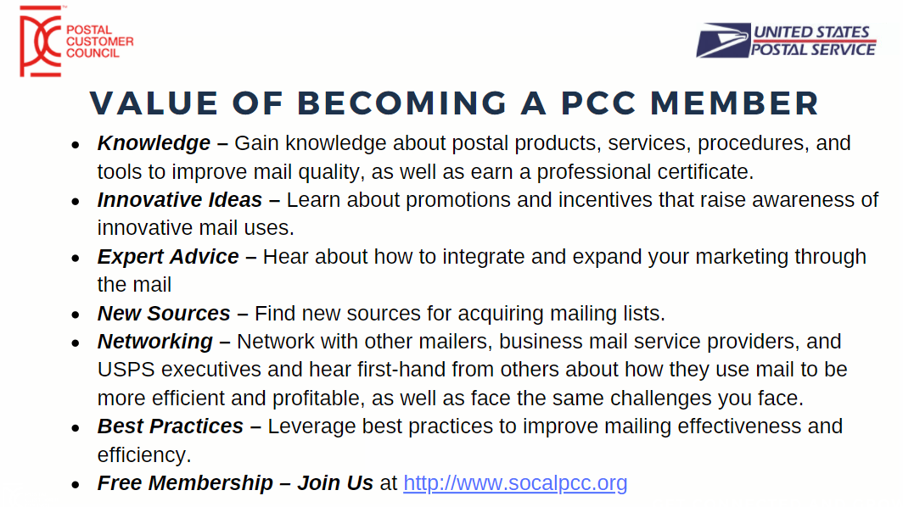
PCC Communications and Marketing
Methods: PCC Marketing Committees develop marketing templates, execute emails, create flyers, mailers, and other marketing materials.
PCC EDUCATION PROGRAMMING
Notes:
Kathy 2 minutes

Slide 25
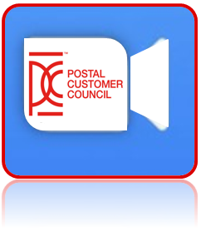
PCC Communications
PCC Alerts:
PCC Insiders
PCC Spotlights
PCC Virtual Event Calendar
If you don’t want to miss these alerts, please subscribe to the PCC Alert
mailing list by contacting PCC@usps.gov.
Industry Alerts:
If you’d like to receive the Industry Alerts, please subscribe to the Industry
Alert mailing list, by contacting IndustryAlert@usps.gov.
PCC EDUCATION PROGRAMMING
Notes:
Sharon 1 minute
Sign up for PCC & Industry Alerts, making sure members are on this
Provide the PCC network with important information regarding PCC related events, webinars, and other news.
PCC Alerts include: include USPS information, Promotions, leadership changes, rate changes,
For the latest alerts Please subscribe to the PCC Alert mailing list by contacting PCC@usps.gov.
inform industry Stakeholders about important information regarding USPS webinars, promotions, products, and other news.
Industry Alerts – mail interruptions, facility closures, system upgrades – messages from

Slide 26
PCC Member to Member Communications
PCC Voice – Our only USPS approved Social Media Outlet
Share links to PostalPro https://postalpro.usps.com/pcc
Be ready to share the value of the PCC – Elevator Speech
Forward PCC Alerts, Industry Alerts, and other email information
Networking
Email us at PCCMktg@usps.gov
USPS ZONE
PCC EDUCATION PROGRAMMING
Notes:
Sharon 2 minutes
How members can help share marketing
Post in PCC Voice - Our only USPS approved Social Media Outlet - share your PCC events, best practices, celebrations etc.. should not be used for personal gain or purposes.
Share the link to PostalPro for multiple resources: find a PCC, PCC Event information, cafés, educational presentations, variety of toolboxes etc.
Include in 30 Second elevator pitch
Forward PCC Alerts, Industry Alerts and other email information to other Industries in Business Mail Community.
Networking across the nation – USPS, Industry and fellow PCCS

Slide 27
Education Programming
Rob Hanks
Industry Co-Chair
rob.hanks@suttle-straus.com
Charles Dandridge
A/Customer Outreach Specialist
Charles.Dandridge@usps.gov
PCC EDUCATION PROGRAMMING
Notes:
Charles and Rob

Slide 28
Educational Topics
Traditional Postal Topics
Postal Rate/Promotions
Seamless Acceptance
Marketing - Direct Mail
Address Change – Return Services
Business Customer Gateway
Informed Visibility
Mailpiece Design
Shipping – Package Delivery
International
Cybersecurity
Traditional Non-Postal Topics
Safety – Weather
Leadership -Skills
Mental Health
Financing/Retirement
Personal Development
Social Media
Value of Mail
Inspirational
Integrating Direct Mail
Networking
Notes:
Rob 2 minutes
Examples of Education Topics

Slide 29
National Center for Employee Development (NCED)
Mail Design Professional
Addressing
AIS Products
Automation Flats
Automation Letters, FCM, and Standard Mail
Basic Mail Design
Classes of Mail
Intelligent Mail Barcode Formats
Postage Payment Methods
Reply Mail
Tads and Tidbits
Basic Mail Design
Mail Center Administration
Mail Center Operations
Mail Center Security
Management Essentials
Sales and Marketing
Technology
Tools and Resources
Executive Mail Center Manager
Two Certification Programs
Host locally or virtually
For more information on
scheduling and pricing contact:
justin.l.windsor@usps.gov
PCC EDUCATION PROGRAMMING
Notes:
Charles 2 minutes

Slide 30
PostalPro
PostalPro is accessible by Postal and Non-Postal visitors
Education Tab
PCC Industry Speaker Database Form
PCC Library
Past Educational events (PPTs and Recordings)
PCC Educational Toolkit
PCC EDUCATION PROGRAMMING
https://postalpro.usps.com/pcc#anchor-5
Notes:
Charles 1 minute

Slide 31
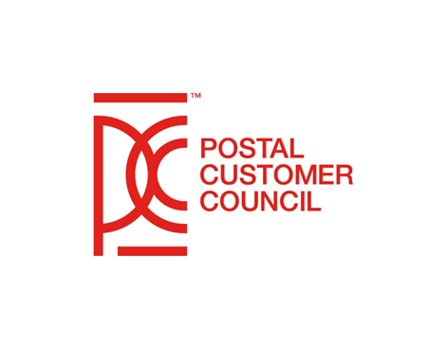
Resources
Joe Banks
Member-at-Large
joseph.banks@usmc.mil
PCC EDUCATION PROGRAMMING
Notes:
Joe

Slide 32
Resources
PCC BlueShare Site
https://ca.blueshare5.usps.gov/sites/igo/pcc/SitePages/Home.aspx
PostalPro
https://postalpro.usps.com/pcc
PCC Postal Administrator Quick Guide
https://postalpro.usps.com/node/9784
PCC Voice LinkedIn
https://www.linkedin.com/groups/8303549
PCC Mailbox
PCC@usps.gov
PCC Communications and Marketing Mailbox
PCCMktg@usps.gov
PCC Insider
PCCInsider@usps.gov
PCC EDUCATION PROGRAMMING
Notes:
Joe 3 minutes
PCC BlueShare Site – USPS access only – provides a wealth of information and resources such as “Building a Successful PCC Guide”, Policy Documents, PCC Logos and Style Guide (which sets the guidelines for logo usage.)
Headquarter Speaker Request forms, PCC Administrators Quick Start Guide, PCC Recognition – PCC Premier Certificate and Leadership Awards guides and nomination forms, NPF and National PCC Day tools and resources, and valuable tutorials
PostalPro – available to all USPS as well as Industry on PostalPro you can find contact information or find a PCCs near you, or information on upcoming PCC events nationwide. PostalPro is also a depository that houses our PCC Mission , Pub 286, recordings from our educational Cafes, webinars, power point presentations, the Education and Marketing toolbox, PCC Insiders, PCC spotlights, updates from Academic Outreach and more.
PCC Postal Administrator Quick Guide – located both on the PCC BlueShare Site and Postal Pro guide designed to assist new PCC Administrators , as well as serve as a refresher for our seasoned Postal Administrators to help keep them on track with their daily and monthly activities, roles and responsibilities.
PCC Voice LinkedIn – Networking tool where PCC members can share best practices and ideas that can be replicated , post videos, pictures, upcoming events and celebrate successes
PCC@usps.gov
PCCMktg@usps.gov
PCCInsider@usps.gov

Slide 33
Resources
PCCAC Industry Executive Board:
Dina Kessler National Industry Chair dkessler@kesslercreative.com
Neal Fedderman National Industry Vice-Chair neal_fedderman@CarMax.com
Kathy Hall Industry Co-Chair
Communications and Marketing kathy@atime4marketing.com
Rob Hanks Industry Co-Chair
Education Programming rob.hanks@suttle-straus.com
Suzi Oswald Industry Co-Chair
Membership Growth and Recruitment Suzi.Oswald@seachangemn.com
Mark Fallon Industry Co-Chair
Strategic Innovation & PCC Policy mmf@berkshire-company.com
Monica O’Connor Member-at-Large Monica.oconnor@moneypages.com
Joe Banks Member-at-Large joseph.banks@usmc.mil
HQ PCC Liaisons:
Atlantic Area Katrina Raysor, Lead Brian Corley, Support
Central Area Sharon Barger, Lead Donna Thabet, Support
Southern Area Da Shiek Woodard, Lead Charles Dandridge, Support
WestPac Area Judy Caldwell, Lead Jacquelyn Gilliam, Support
PCC EDUCATION PROGRAMMING
Notes:
Joe 2 minutes

Slide 34
Closing
Value
Resources
Committee’s Commitment
PCC
Member
PCC EDUCATION PROGRAMMING
Notes:
Dina 1 minute

Slide 35
Questions and Answers

Slide 36
Many Thanks

